Slide 1
ANTIBIOTICS
When Antibiotics Stop Working
How Repayment Options are
Like Medication

Slide 2

How are General Forbearances like Antibiotics?
STUDENT LOANS
ANTIBIOTICS

Slide 3
General Forbearances
General Forbearances
JUST
SAY
NO!
(And Find a Better Solution!)

Slide 4
General Forbearances
General Forbearances are discretionary and not mandatory or an entitlement, however can be used to prevent default
Uses:
  Bring account current
MOHELA’s Strategy:
  Bring account current
  Not to offer forbearances that end more than 60 days into the future
  There may be exceptions to this strategy

Slide 5
General Forbearances Disadvantages
  Capitalized interest
  No interest is subsidized
  Principal balance continues to increase due to capitalization and may result in compounding interest
  Limited time available
  Time spent in a General Forbearance does not count toward Public Service Loan Forgiveness or IDR forgiveness

Slide 6
Deferment Disadvantages
Deferments are an entitlement
Not necessarily as advantageous for the borrower as an Income-Driven Repayment (IDR) option
  Government only pays interest on subsidized portion
  Interest accrued on the unsubsidized portion will capitalize
  Limited time available for most deferments
  Time spent in a deferment does not count toward Public Service Loan Forgiveness or IDR forgiveness (IDR exception: periods of Economic Hardship Deferment as defined in the regulations)

Slide 7
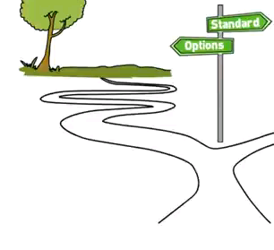
Income Driven Repayment (IDR) Options
“Collector” → “Repayment Assistance Counselor”
Standard level payments remain the default repayment option
IDR Options:
  Income-Based, Income-Contingent (Direct Loans only), and Pay As You Earn (Direct Loans only)
  $0 monthly payment possible
  Annual renewal required

Slide 8
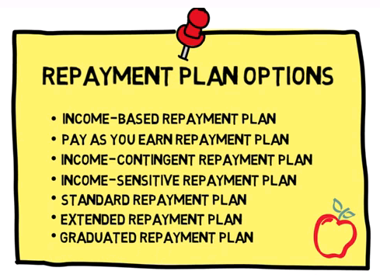
Repayment Plan Options

Slide 9
IDR Changed How We Collect on Direct Loans
The economy is still recovering from the “Great Recession”
The national unemployment rate is 7.0%
Many Americans are unemployed or underemployed
In response to a need for different types of repayment options and to help borrowers avoid defaulting on their student loans, Congress expanded repayment plans

Slide 10
IDR Advantages
IDR Advantages
Accrued interest amounts above the installment amount for subsidized loans is paid by the government for up to 3 consecutive years (Not applicable for ICR plan)
Remaining balance may be forgiven after 20 (Pay As You Earn) – 25 (IBR/ICR) years of qualifying events
10 years to repay if partial financial hardship ends
ICR – 10% capitalization limitation based on loan balance at the time the borrower entered repayment
Payment amount based on family size and income
Qualifying payment plan for PSLF (if borrower qualifies)

Slide 11
Jodi S.: A real-life example
Jodi S.: A real-life example
Her loan transferred at the end of a long forbearance
She applied for an Economic Hardship Deferment, but was denied because her income was too high
She knew she was unable to pay and avoided the Servicer

Slide 12

Servicer Finally Establishes Contact with Jodi!
Servicer Finally Establishes Contact with Jodi!
Received a letter from Servicer CEO at 220 days delinquent
Letter encouraged borrower to call a Repayment Assistance Hotline or contact the CEO directly if Hotline staff is unable meets her specific and unique needs
Unique letter packaging

Slide 13
Jodi’s Response
Jodi’s Response
Jodi responded with an angry email to the CEO. She has four children, is a school teacher making $41,000 per year, and is going through a “horrific and heartbreaking divorce.”
Finally, the Servicer established contact for the first time!
Solution: She qualified for an income-based repayment plan resulting in a $0 monthly payment.
She is now eligible for Public Service Loan Forgiveness Plan.

Slide 14

A Win-Win Outcome for Jodi and Others
A Win-Win Outcome for Jodi and Others
Getting Jodi in an income-driven repayment
plan benefits:
Jodi
School
Taxpayer
Servicer

Slide 15

What do these numbers represent?
What do these numbers represent?
3.8%
26%
4,423
$99.2 million

Slide 16
Results from July 1, 2012 – June 30, 2013
Results from July 1, 2012 – June 30, 2013
Average less than 3.8% of all borrowers currently in a repayment status greater than 90 days delinquent per quarter.
MOHELA has resolved an average of 26% of borrowers 180 days+ delinquent from the previous quarter by the end of the quarter.
  i.e. The quarter ending June 2013 had 15,297 borrowers greater than 180 days delinquent at the beginning of the quarter. 4,423 (28.9%) of those borrowers were resolved.
    $99.2 million represents balance of 4,423 borrowers brought current last quarter.

Slide 17
Question: How do you reach borrowers not responding to your standard mailings and collection calls?
Discussion
Discussion
Answer: Try unique and innovative ways to establish contact. Listed below are a few ideas. Is anyone willing to share their latest unique ways of establishing contact with students/borrowers?

Slide 18
How Can You Work With Servicers to Protect Your Portfolio?
How Can You Work With Servicers to Protect Your Portfolio?
Tell students about the various repayment plans
Encourage them to visit their servicer’s website or call
Use servicer portfolio reports and NSLDS
Borrowers can apply online for Income-Driven Repayment Plans on studentloans.gov, which interfaces with the IRS database to retrieve most recent tax information
  This process allows for a more borrower friendly, quicker process
    Retrieval of loan data from NSLDS
    No need to find paper tax returns
    Ability to manually input family size that may differ from tax return
    Servicer receives electronic application the next business day
  Can be utilized for both first time and renewal applications
StudentLoans.gov

Slide 19
William C. Shaffner
Director of Business Development and Government Relations
wills@mohela.com
636.733.3830

